Slide 1

IMP77 Internals
A RETROGRADE Language and Compiler

Slide 2
OVERVIEW
Get and build the Compiler
Compiler Framework
Interpreting iCode
Enhancements
Implemented Enhancements
Embedding machine code
16-bit integers
Intel x86 and iCode
Demon-stration

Slide 3
Get AND BUILD the COMPILER

Slide 4
GET the Prerequisites
https://github.com/siliconsam/imp2022
README indicates prerequisites
Documentation about iCode and IBJ formatsi n the docs folder
Contains updated IMP77 compiler + source
Assume you are using a Linux machine with gcc compiler present
Update Linux environment
sudo apt update
sudo apt upgrade
Obtain required and useful utility
sudo apt install dos2unix
Ensure you can compile/link 32-bit code
sudo apt install gcc-multilib
Obtain pascal compiler used to build useful utilities
sudo apt install fpc

Slide 5
GET the IMP COMPILER
From GitHub https://github.com/siliconsam/imp2022
Download the ZIP file of the code
Unzip into a folder on a LINUX machine
Check you have
read, write, execute access to /usr/local folder tree
Access to the gcc compiler
cd into the pass3 folder
make install
cd into the lib folder
make bootstrap
cd into the compiler folder
make bootstrap
You should now have a working IMP compiler for Linux
You might want to install some useful utility programs (written in FreePascal)

Slide 6
COMPILER FRAMEWORK

Slide 7
Compiler COMPONENTS (GRAMMAR AND SYNTAX ANALYSYS)
Compiler suite consists of 3 phases/passes (but 4 programs!)
Each pass implemented as a separate program
Additional program to generate lex/parse tables from IMP77 grammar
Takeon is the lexer/parser generator program
Input = the IMP77 grammar
Output = the lex/parse tables used by pass1 of the IMP77 compiler suite
Phase 1: pass1 – analyses IMP77 source (.imp)
Uses lex/parse tables generated by takeon
Reads external permanent IMP77 definitions (routines/variable/constants) in stdperm.imp
Reads IMP77 source file
Generates iCODE intermediate code (.icd) + listing file

Slide 8
Compiler COMPONENTS (CODE GENERATION + OBJECT FILE CREATION)
Phase 2: pass2
reads the iCode data (.icd file) from pass1
uses iCode to generate machine code
creates (.ibj file) with machine code + symbol data
CAVEAT (only Intel 386 32-bit code at present)
Phase 3: (pass3coff , pass3elf)
reads .IBJ file containing machine code + symbol data file
creates an object code file (.obj or .o)
pass3coff generates object file in Windows COFF format (32-bit only)
pass3elf generates object file in Linux ELF format (32-bit only)

Slide 9
Compiler COMPONENTS (Library and Linking)
Program compilation references library code
Almost all library code written in IMP77
(some embedded Intel 386 assembler code used)
Interface to C file I/O held in single C source file
(only non-IMP77 source)
(common to Windows/Linux)
Program object files must be linked by appropriate linker
Window linker in Visual Studio (needs COFF format object files)
Linux linker from GCC collection (needs ELF format object files)

Slide 10
TAKEON Program
Written in IMP
Common to Windows and Linux compiler versions
Parses the IMP77 grammar definition file
Generates lex/parse tables for use by IMP parser (pass1)
Also generates debug data for the parse and lex table sections
Could generate tables for other languages (i.e. Pascal)
Command line
takeon i77.grammar=i77.tables.inc,i77.parse_debug,i77.lex_debug

Slide 11
PASS 1 (syntax Analysis)
Written in IMP77
Common to Windows and Linux compiler versions
Parses the IMP77 source text
Also reads standard permanent definitions (stdperm.imp)
Uses a table-driven parser
Generates intermediate code (iCode)
iCode describes code generation steps
Common to all machine/operating system versions of IMP77 compilers
Intermediate code could be extended for different languages (Pascal)

Slide 12
INVOKING PASS 1 (Syntax analysis)
Command line:
pass1 <src>.imp,stdperm.imp=<src>.icd:b,<src>.lst
<src>.imp
is the IMP77 source
stdperm.imp
file of standard permanent IMP77 definitions
<src>.icd
Generated iCode data, describing code generation steps
:b indicates this is a binary file
<src>.lst
Listing file showing input and reporting any errors

Slide 13
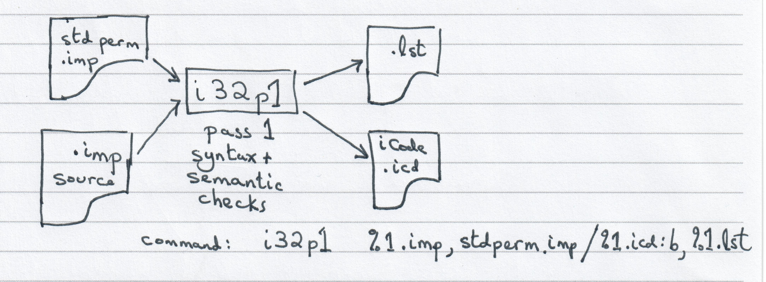
INVOKING PASS 1 (Syntax analysis)

Slide 14
PASS 2 (code generation)
Written in IMP77
Source common to both Windows and Linux
Assumes target is an Intel 386 architecture machine
(32-bit integer arithmetic)
There are versions of Pass2 for other “obsolete” machines (e.g. PDP-11)
But NO compiler executables available
(except for VAX/VMS and old version of RISCOS for ARM)
Depends on format of intermediate code (iCode) from Pass1

Slide 15
INVOKING PASS 2 (CODE GENERATION)
Command line:
pass2 <src>.icd:b,<src>.imp=<src>.ibj,<src>.cod
<src>.icd:b
Is the iCode binary file
<src>.imp
is the corresponding IMP77 source
<src>.ibj
Intermediate object file containing machine code and symbol data
<src>.cod
Listing file showing source input and corresponding generated machine code

Slide 16
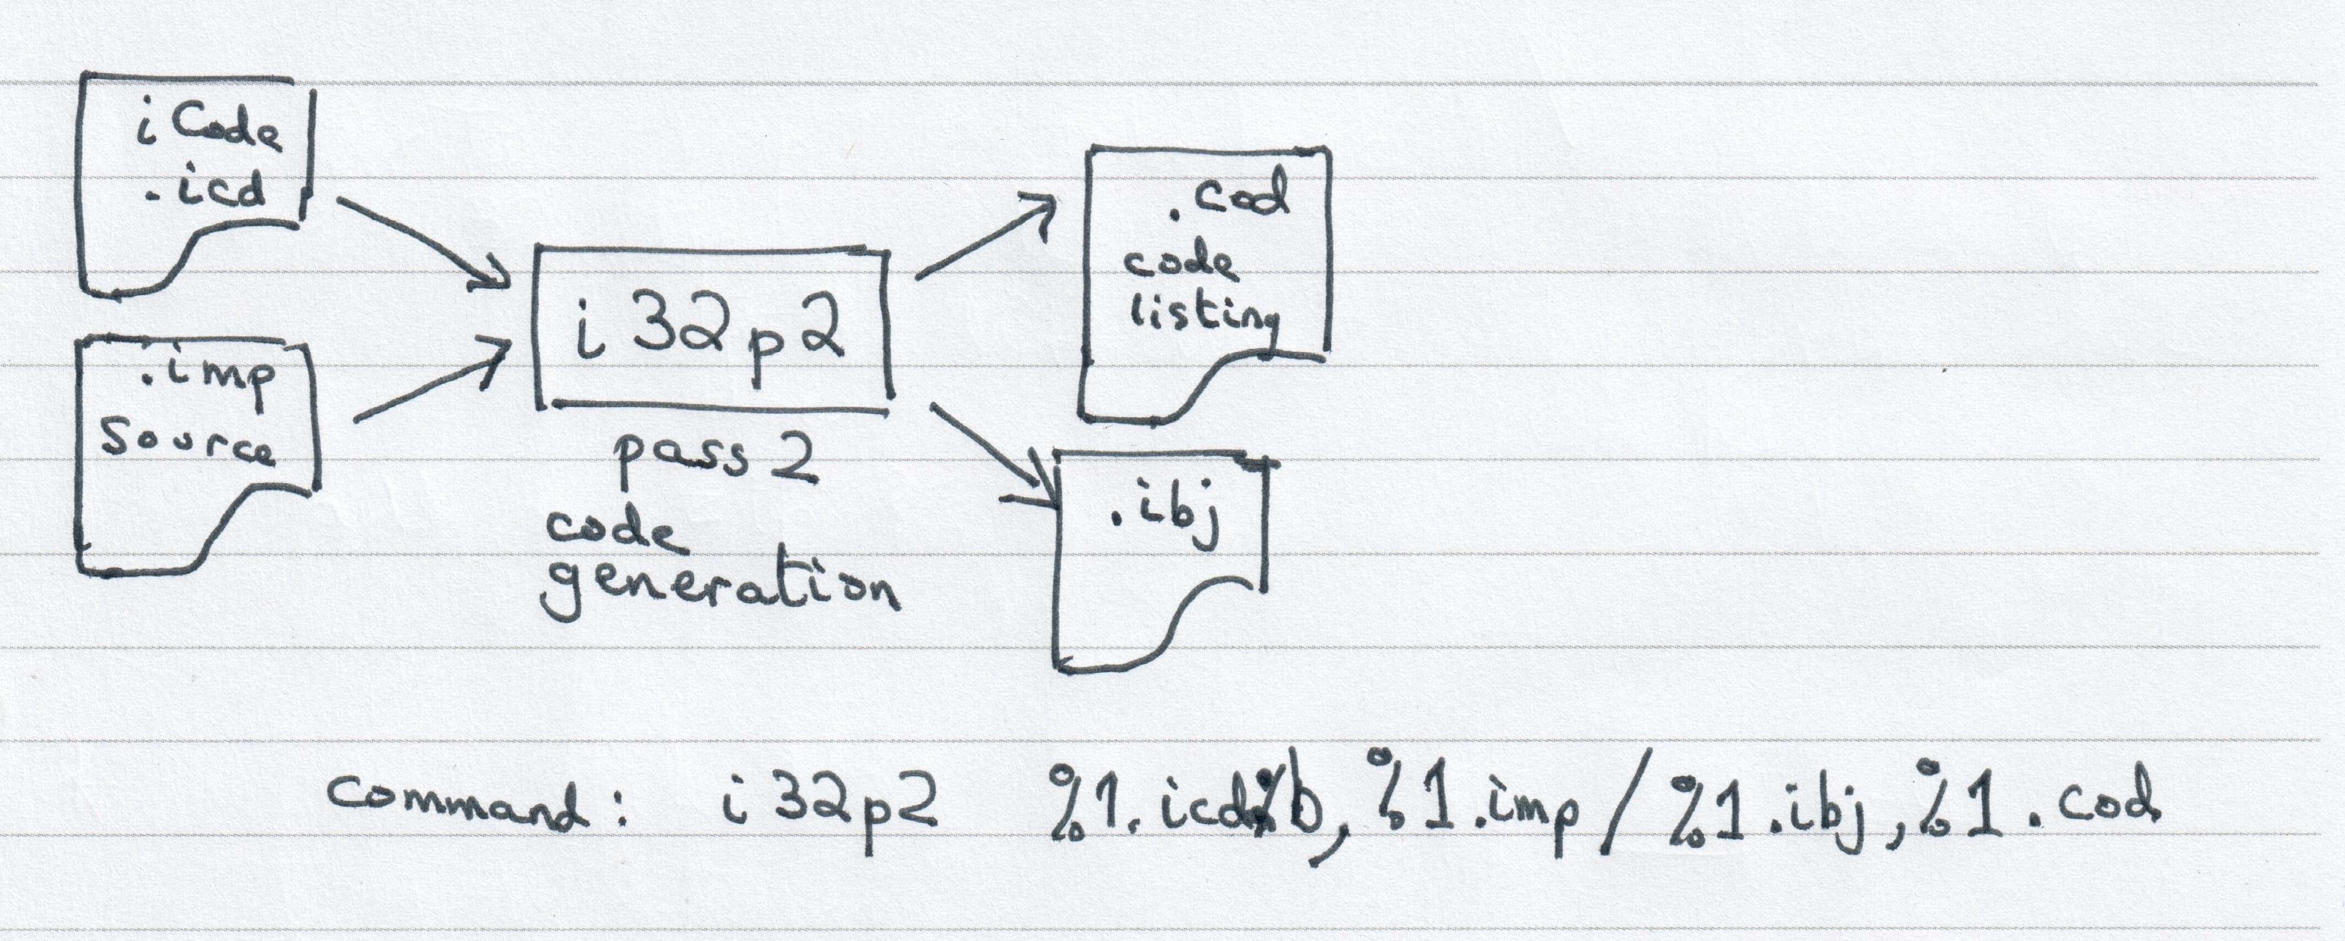
INVOKING PASS 2 (CODE GENERATION)

Slide 17
PASS3 (OBJECT FILE GENERATION)
Converts the intermediate object file to an actual object file
Two versions
Windows version generates 32-bit PE/COFF object files
Linux version generates 32-bit ELF object files
Both implemented in C
But, new version of pass3 available
Ibj2coff
Generates Windows PE/COFF object file
implemented in Free Pascal

Slide 18
INVOKING PASS3 (OBJECT FILE GENERATION)
COFF file version
Command line:
pass3coff <src>.ibj <src>.obj
ELF file version
Command line
pass3elf <src>.ibj <src>.o
COFF version (Pascal implementation)
Command line
Ibj2coff <src>.ibj <src>.obj

Slide 19
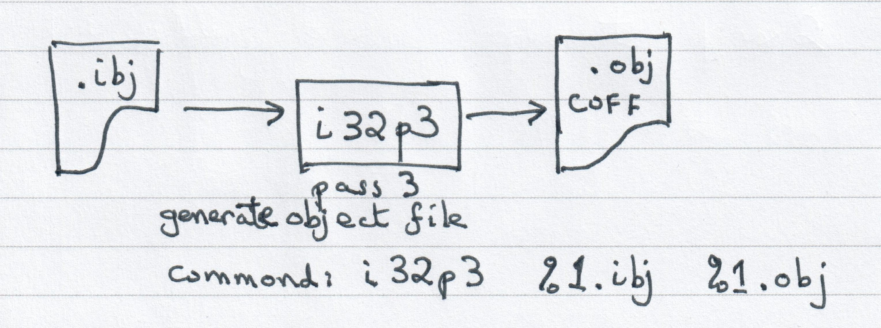
INVOKING PASS3 (OBJECT FILE GENERATION)

Slide 20
NEW IMP77 UTILITY TOOLS
icd2assemble – reads binary .icd / iCode file and generates textual version
assemble2icd – reads textual iCode and generates binary .icd /iCode file
ibj2assemble – reads pseudo binary .ibj file and generates textual version
assemble2ibj – reads textual ibj and generates pseudo-binary .ibj file
ibj2coff – reads .ibj file and generated PE/COFF file (= pass3coff)
coff2dump – reads PE/COFF object and generates debug dump file
Similar to dumpbin for Windows (from Visual Studio)
All the above utility programs are written in Free Pascal
another “retrograde” language?
slimibj – reads the .ibj file and removes surplus ibj records
Written in IMP

Slide 21
Interpreting iCode (CODE GENERATION)

Slide 22
ICODE INSTRUCTIONS DOCUMENTATION
ICODE instructions described in “ICode2v0.pdf” in the docs folder
Grouped by
Access Variables
Assignment
Block Structure/Call
Compiler Directives
Embedding Machine Code
Jumps and Labels
Parameter/Variable declarations
Stack operations

Slide 23
ICODE INTERPRETATION USEs STACKS
Uses 3 stacks
Symbol table stack
Storing symbol definitions
Routines
Variables
Record formats
Used for symbol visibility
Variable Access stack
Stacks variable access (based on symbol table definitions)
Operation/instruction stack
add, subtract, multiply etc

Slide 24
ICODE INSTRUCTIONS USING SYMBOL STACK
DEF <n>,<name>,<variable descriptor>
Variable referenced by tag number <n>, with type/size information
Forms a symbol table as a stack (separate from the iCode instruction stack)
Allows forward specification of symbol
IMP77 allows nested procedures (like PASCAL but unlike C)
Entry into procedure “pushes” new symbol table level
Exit from procedure “pops” symbol table level

Slide 25
ICODE INSTRUCTIONS USES VARIABLE Stack
Variable data copied from Symbol Stack
Variable still referenced by tag number <n>, with type/size information
Used to form instructions to access (read/write) the variable data
ASSPAR
Current variable is assigned as a parameter to a procedure
TOS is passed as the next parameter to SOS
TOS is removed from the stack leaving SOS as the new TOS.
ASSVAL
Assign value to variable
TOS represents value to be assigned, SOS represents target variable
TOS, SOS both removed from the stack
CALL
The procedure described by TOS is called.
If TOS is a procedure which returns a result TOS is replaced by that result
Otherwise TOS is removed from the stack.

Slide 26
ICODE INSTRUCTIONS (USES Operation Stack)
PUSH <n>
Stacks reference to tag variable <n> onto the operation stack (new TOS)
PUSHI <n>
Pushes an integer value <n> onto the instruction stack (new TOS)
PUSHS <string>
Pushes the constant <string> onto the instruction stack (new TOS)
SUB
Causes generation of instruction sequence which subtracts 2 variables/values
Variables could be byte/word/long integers or real numbers
Subtracts TOS from SOS
pops TOS,SOS and push result as new TOS
ADD
Causes generation of instruction sequence which adds 2 variables/values
Variables could be byte/word/long integers or real numbers

Slide 27
ICODE INSTRUCTIONS FOR CODE Flow Sequencing
LINE <n>
Indicates following iCode instructions are generated by IMP source line <n>
LOCATE <n>
Location for label <n>
Beware duplicate declarations of <n> are actually different label locations
FORWARD <n>
Generate code to jump forward to following label <n>
REPEAT <n>
Generate code to jump backward to preceding label <n>
Conditional Jumps <n>
Generate code to test appropriate condition and jump to label <n>
JG – Branch if Greater Than
JLE – Branch if Less Than or Equal
…

Slide 28
EXAMPLE ICODE SEQUENCES
Imp77 code sequence (assume the bilbo routine is already defined and has “tag” = 2)
%integer fred = 4
Bilbo( “Variable name =“, fred + 8)
ICODE sequence
DEF 5, “fred”, integer { symbol “fred” has tag = 5 }
PUSH 5 { pushes def of “fred” onto stack }
PUSHI 4 { pushes integer value of 4 onto stack }
ASSVAL { assigns t4 to “fred”, s2 values popped from stack }
PUSH 2
PUSHS “Variable name =“
ASSPAR
PUSH 4
PUSHI 8
ADD
ASSPAR
CALL

Slide 29
Showing ICODE and GENERATED MACHINE CODE
To show the Intel instructions generated by an ICODE sequence
Set a shell variable IMP_DIAGNOSE=16 before compiling the IMP code
Linux:
export IMP_DIAGNOSE=16
Windows
set IMP_DIAGNOSE=16
The ICODE will then be printed in the .cod listing file generated by pass2
Use the –Fc –Fs –Fi options on the shell script to run the IMP compiler
Eg Linux: imp77 –Fc –Fs –Fi bilbo.imp
Eg Windows : imp32 –Fc –Fs –Fi bilbo.imp

Slide 30
INTEL X86 AND iCODE (Declaring NESTED PROCEDURES)
IMP77 allows nested procedures
DEF iCode is where a procedure/routine starts being defined (which may be nested)
Intel x86 has 2 special instruction to assist in nesting routines
ENTER <level>
<level> indicates the nesting level of the routine definition
placed at the start of code implementing routine definition
it allows additional storage for pointers to previous <level> stack frames
pushes these pointers into the reserved memory
maximum <level> allowed is 32
LEAVE
placed at end of routines code definition
pops from stack the <level> pointers
RET instruction immediately follows LEAVE instruction

Slide 31
INTEL X86 AND iCODE (CALLING PROCEDURES)
Standard CALL mechanism used
“push” parameters onto stack before invoking CALL instruction
“pop” stack by size of parameters
N.B. IMP77 pushes parameters onto stack left to right in procedure call
First parameter is first on stack …
C pushes parameters right to left
Last parameter is first on stack!!!

Slide 32
ICODE and INTEL X86 (IMP77 inside Window/Linux)
IMP compiler assumes code is embedded inside a C based O/S environment
Allows access to O/S environment
E.g. access the program arguments
E.g. access the “shell” variables
Caveats
Beware C strings are null terminated and could be longer than 255 characters
Accessing system provided routines use the C calling standard
E.g. O/S provided routine parameters in opposite order to IMP77 routine parameters
New IMP library routines already implemented to access O/S environment
See new version of stdperm.imp (on github)

Slide 33
ENHANCEMENTS

Slide 34
IMPLEMENTED ENHANCEMENTS
Modify PASS2 to be able to insert machine code embedded in IMP source
PASS2 can recognise embedded machine code – DONE
PASS1 already allowed embedded machine code
Work involved
Extensions to machine code assembler routine
Direct insertion of machine code into .ibj file stream
Partially implemented in new PASS2 (available in Github).
Implement true 16-bit integer type – DONE
Work involved
upgrade to iCode interpreter routines
Extra Intel 386 instructions added
Rewrite IMP runtime library from C to IMP77 – DONE with one exception
Add capability of Random Access files (read/write) – DONE

Slide 35
EMBEDDING MACHINE CODE

Slide 36
EMBEDDING MACHINE CODE
IMP77 has 2 mechanisms to embed machine code in IMP77 source
Assembler notation
*<instruction>_ <parameters>
Examples
*MOV _ %EAX,[%EBP+8]
*ADD _ %EAX,#118
*MOVSX_ %EAX,%AX
Raw binary insertion
*=<byte integer>
Examples
*=16_0f
*=16_bf
*=16_c0

Slide 37
EMBEDDING MACHINE CODE (ASSEMBLER)
Assembler notation
*<instruction>_ <parameters>
Needs parser for assembler text
Recognition of instruction and legal parameters
Conversion from assembler text to actual binary instruction
Recognition of registers, addressing mode, values
What about assembler directives?
Example
*MOVSX_ %EAX,%AX
Is MOVSX legal instruction?
Is parameter sequence %EAX,%AX legal for MOVSX?
Are %EAX,%AX legal registers?

Slide 38
EMBEDDING MACHINE CODE (RAW BINARY)
Raw binary insertion
*=<byte integer>
Is specified number in byte integer range 0..255 9or -128..127?
Does the complete sequence form a valid instruction for the instruction set?
Examples
*=16_0f { MOVSX %EAX,%AX }
*=16_bf
*=16_c0 { the Mod/rm byte to sign extend 16-bit to 32-bit from %AX to %EAX }
This is a valid byte sequence for MOVSX %EAX,%AX
Useful mechanism to add code if “assembler” is missing certain instructions

Slide 39
IMPLEMENTING 16-bit INTEGERS (IN A 32-BIT ENVIRONMENT)

Slide 40
16-BIT INTEGERS
Imp77 allows concept of %short %integer which is a 16-bit integer
Original Intel 386 IMP77 compiler “cheated”
Implemented %short %integer as same size as %integer (32-bit signed value)
How to implement a %short %integer as a genuine 16-bit signed value?
1) Alter IMP77 grammar to indicate %short %integer takes 2 bytes
2) Ensure iCode DEF remembers size is 2 bytes
3) Modify every arithmetic iCode instruction (i.e. ADD,SUB) to be aware of 16-bit values
4) Modify ASSPAR, ASSVAL codes to be 16-bit aware.
There were problems for changes 3) and 4) !!!

Slide 41
PROBLEMS with 16-BIT INTEGERS
Problem: What about arithmetic operations on 16-bit integers?
Numeric overflow/underflow
A problem for ADD, SUB iCODE instructions
Assignment to/from 16-bit integers and 32-bit integers
creates a problem for ASSVAL iCode instruction
Solution:
Store in a WORD location (= 16-bit)
Sign extend 16-bit integer into a 32-bit integer using the Intel MOVSX instruction!
Do all 16-bit integer arithmetic as 32-bit arithmetic in registers
Check each 16-bit arithmetic operation for out-of-range results
Check assignment into 16-bit variable is in 16-bit range.
Signal an appropriate IMP77 event for error situations

Slide 42
MORE PROBLEMS with 16-BIT INTEGERS
Problem: What about passing 16-bit integers
as parameters
Being returned as a function result?
Constraints
Parameters are passed on the stack for Intel x86
NB. Intel x86_64 uses the extra registers to pass parameters into a routine
Function results passed back in the %EAX register
Intel x86 instructions only allow
Register, Register
Register, Memory
Memory, Memory NOT allowed
BUT, the %ESP (Intel 386 stack pointer) must be aligned on a 4-byte boundary
A 16-bit integer takes 2 bytes so there would be stack alignment errors!!

Slide 43
SOLVING PROBLEMS with 16-BIT INTEGERS
Solution:
Pass 16-bit parameters as 32-bit values
Use Intel 386 MOVSX instruction before stacking
MOVSX sign extends a 16-bit integer into a 32-bit integer
Truncate 32-bit values in %EAX register to be 16-bit integers
E.g. take the %AX register value

Slide 44
POTENTIAL ENHANCEMENTs

Slide 45
POSSIBLE ENHANCEMENTS
Write PASS3 PE/COFF generator in IMP77
Try to eliminate embedded instruction selection
Modify PASS2 to contain jump optimisation and be the only pass for instruction selection
Write PASS3 ELF generator (for Intel 386 32-bit) in IMP77
Upgrade Intel x86 32-bit compiler suite to generate 64-bit code
Needs 64-bit integer type
Needs 64-bit address data type
These new types likely to cause problems with historic IMP program source
Create new compiler suite for ARM instructions (native to Raspberry Pi)
New version of PASS2 to generate ARM instructions
Might need definitions of new 64-bit integer/address datatypes
Modify PASS3 ELF generator for ARM

Slide 46
DEMON-STRATION PREREQUISITES
https://github.com/siliconsam/imp2022
Documentation about iCode and IBJ formatsi n the docs folder
Contains updated IMP77 compiler + source
From GitHub
Download the ZIP file of the code
Unzip into a folder on a LINUX machine
Check you have
read, write, execute access to /usr/local folder tree
Access to the gcc compiler
cd into the pass3 folder
make install
cd into the lib folder
make bootstrap
cd into the compiler folder
make bootstrap
You should now have a working IMP compiler for Linux
You might want to install Free Pascal to build some useful utility programs

Slide 47
DEMON-STRATION

Slide 48
REFERENCES
Useful URLs
http://history.dcs.ed.ac.uk/archive/languages/
Useful IMP program source
http://history.dcs.ed.ac.uk/archive/staging-area/EDINBURGH_REUNION/imp77-vax/
Imp source of an IMP77 compiler for the VAX (under VAX/VMS)
https://github.com/siliconsam/imp77
Contains original “working” compiler + source (from Edinburgh Uni website)
Useful documentation about IMP language and compiler implementation
https://github.com/siliconsam/imp2022
Documentation about iCode in the docs folder
iCode2v0.pdf
IBJ Format 2v0.pdf
Contains updated IMP77 compiler + source
https://www.felixcloutier.com/x86/
Lists most x86 instructions with assembler and binary format
Interesting URL
https://www.cs.otago.ac.nz/staffpriv/ok/anti-imp.htm

